Slide 1

Assignment 1

Slide 2
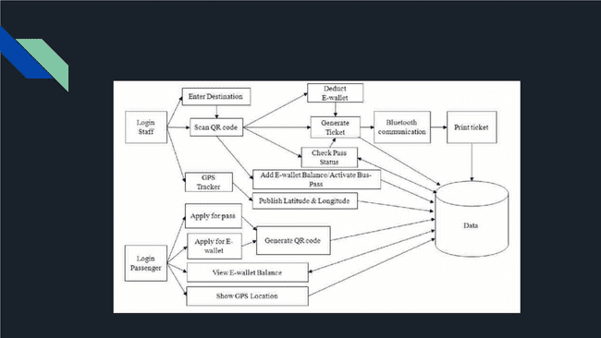
System Architecture

Slide 3

Cohesion
Functional Cohesion
Seat assignment to a bus passenger and payment file are in the same module which work together to fulfill
a single purpose. Hence, it can be called Functional Cohesion.
Communicational Cohesion
Seat canceled File and Cancel receipt File operate on the same data. Therefore, we consider it as
Communicational Cohesion.
Sequential Cohesion
In the cancellation module Seat canceled File, return payment File and cancel receipt file as the data which
is the output of seat canceled activity is used as input data for the next activity. Therefore, it is considered as
Sequential Cohesion.
Logical Cohesion
Ticket generation file and Cancel receipt file perform similar logical functions. Therefore, there exists a
Logical cohesion.

Slide 4
Coupling
Data Coupling
The reservation module and login module are examples of data Coupling because they are both
dependent on the data of the user.
External Coupling
The bus management module is quite a good example of external Coupling as it's dependent on external
modules for maintenance and schedule.
Common Coupling
The reservation module and cancellation module can be said to be common coupling as a change in the
cancellation module will affect the reservation module.
Control Coupling
The login module, reservation module and cancellation module can be control coupling because the flow of
information is controlled between them.

